Slide 2
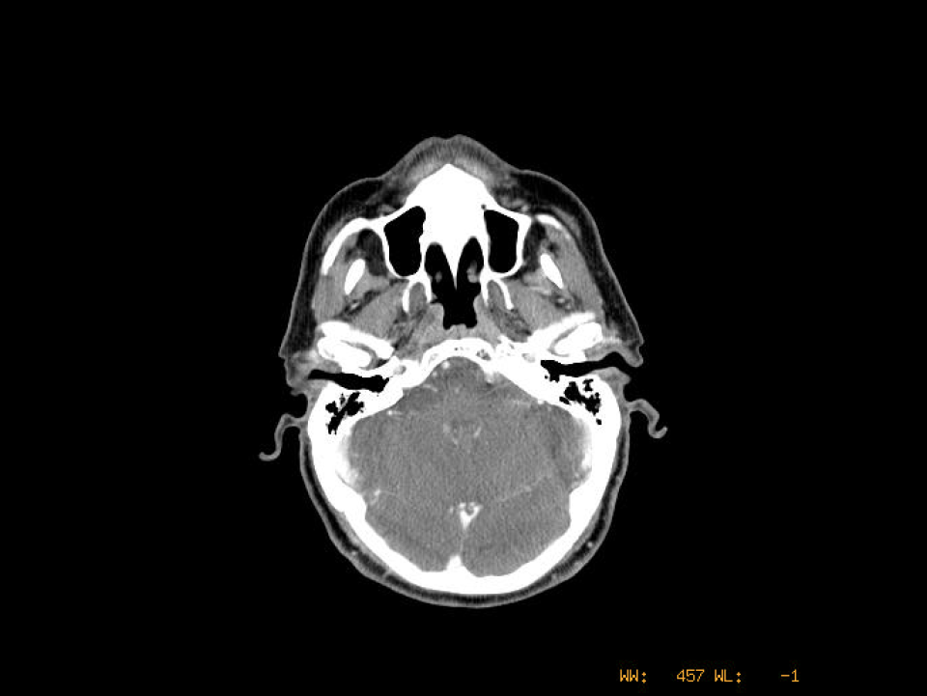
Coronoid process of mandible
Mandibular condyle
External auditory canal
Mastoid air cells

Slide 3
RP
Nasopharynx
Pharyngeal wall
Soft palate
Pharyngeal tumors with other neck nodes (+)
temporalis
Lateral pterygoid plate
masseter
Lateral pterygoid
Prevertebral muscles (longus colli and capitus)

Slide 4
Internal Carotid

Slide 7
Medial pterygoid
Retromandibular vein
Internal Carotid
Styloid process
Internal Jugular Vein

Slide 9
Dens – C2 odontoid process

Slide 10
Level II
Nasopharynx
Oropharynx
Hypopharynx
Larynx
Major salivary glands
IIB more likely NP, OP
Oral tongue
Medial pterygoid
IIA/B dividing line is posterior edge of internal jugular vein
Level II begins at lateral process of C1 (lateral skull base), extends medially to the carotid and paraspinal muscles, laterally to edge of SCM and platysma

Slide 11
masseter
parotid
SCM

Slide 14
Level IB
Oral cavity
Anterior nasal cavity
Submandibular gland
Soft tissue of mid-face
Anterior digastric
Submandibular gland
IB starts at top of submandibular gland and is limited medially by the anterior belly of the digastric muscle
Retromandibular vein

Slide 16
Level IA
Lower lip, floor of mouth,
Anterior oral tongue,
anterior alveolar ridge
parotid

Slide 17
Base of tongue
IB limited by post edge of submandibular gland
Level IIA/B dividing line is posterior edge of internal jugular vein
Level II extends medially to carotid artery, paraspinal muscles, laterally to the edge of the SCM and platysma
SCM

Slide 21
Level V
Nasopharynx
Oropharynx
Subglottis
Hypopharynx
Cervical esophagus
Thyroid
Hyoid bone
Retropharyngeal nodes terminate at level of hyoid bone
Level V begins at
level of hyoid bone

Slide 22
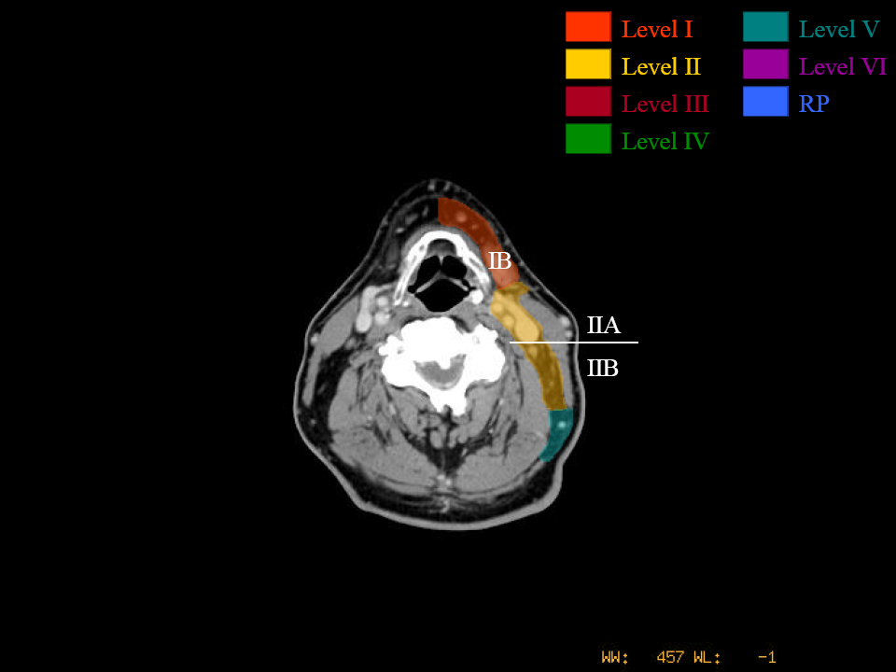
IB ends mid-hyoid
Level II ends at body of hyoid bone (surgically, ends at carotid bifurcation)

Slide 23
Level III
Oral cavity
Nasopharynx
Oropharynx
Hypopharynx
Larynx
Epiglottis
Hyoid bone
Superior horn of thyroid cartilage
Pyriform sinus
Internal Carotid Artery
SCM
External Carotid Artery
Internal Jugular Vein
External Jugular Vein
Level III starts below hyoid bone
Medial limit is internal carotid, and paraspinal muscles
Lateral limit is medial edge of SCM
Posterior limit is posterior edge of SCM

Slide 24
Common Carotid Artery

Slide 25
Vertebral artery
Scalenes
Levator scapulae
Deep cervical muscles
(rectus, longus)
Trapezius

Slide 26
Level V extends anterior to the SCM, posterior to the trapezius, laterally to the platysma and skin, and medially to the paraspinal muscles

Slide 27
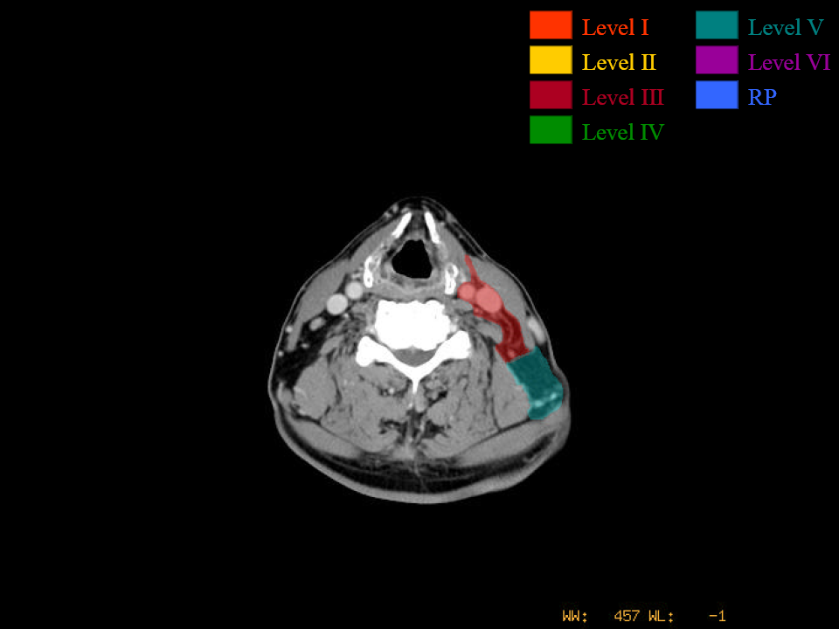

Slide 29
Thyroid cartilage
Thyroid notch

Slide 30
Arytenoid

Slide 31
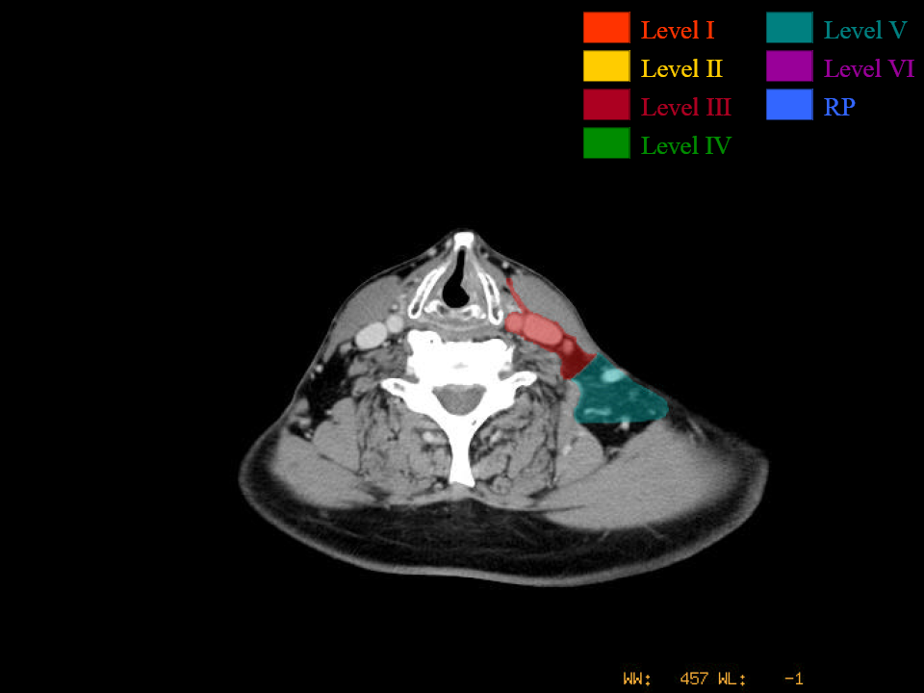
False and true cords

Slide 32
Carotid
Internal Jugular
External Jugular

Slide 33
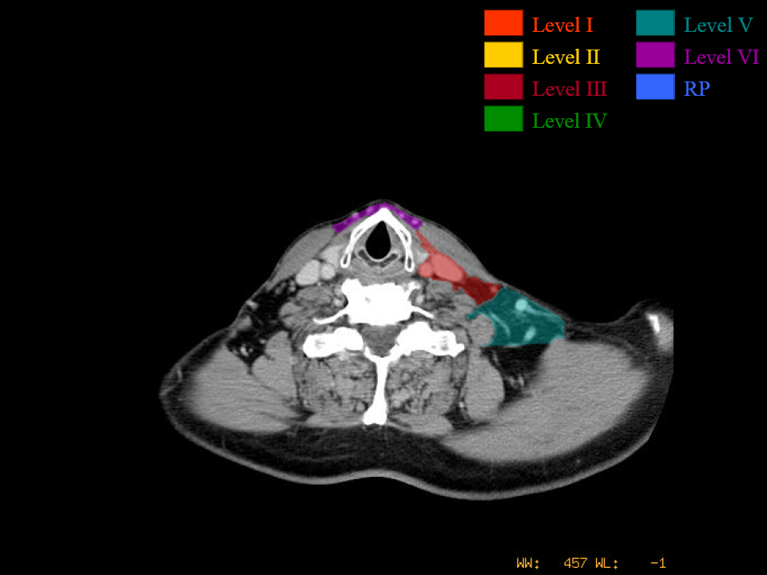
Level VI
Thyroid
Glottis
Subglottis
Hypopharynx
Cervical esophagus
Thyroid cartilage
Level VI begins below thyroid cartilage
Posterior SCM dividing Levels III and V
Level V extends to anterior trapezius

Slide 34
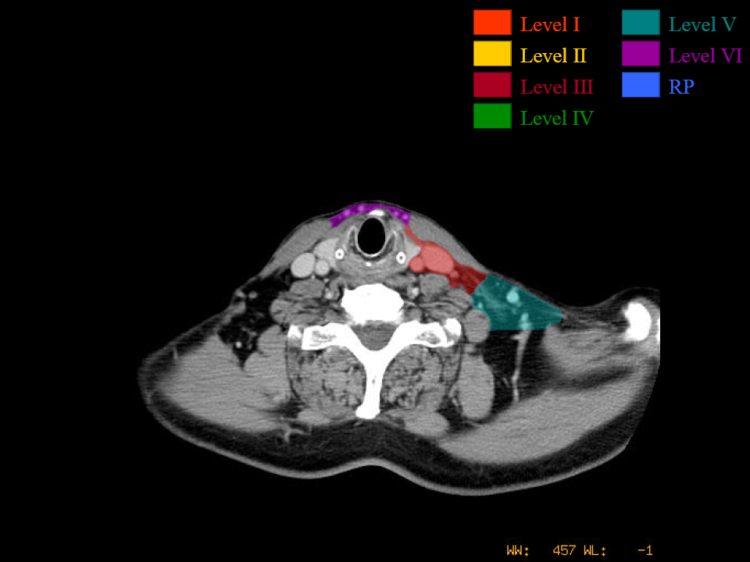
Inferior horn of thyroid cartilage

Slide 35
Common Carotid
Internal Jugular Vein
Level V ends at
level of cervical transverse vessels

Slide 36
Level IV
Hypopharynx
Larynx
Cervical esophagus
Cricoid cartilage
Level IV starts below the cricoid cartilage
SCM

Slide 39
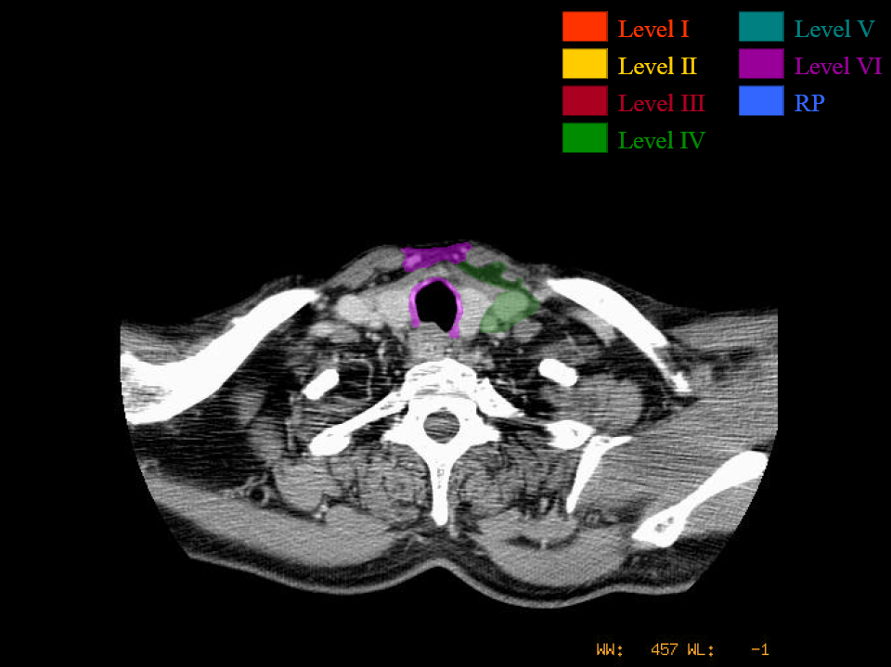
Level IV ends 2 cm above the sternoclavicular joint

Slide 40
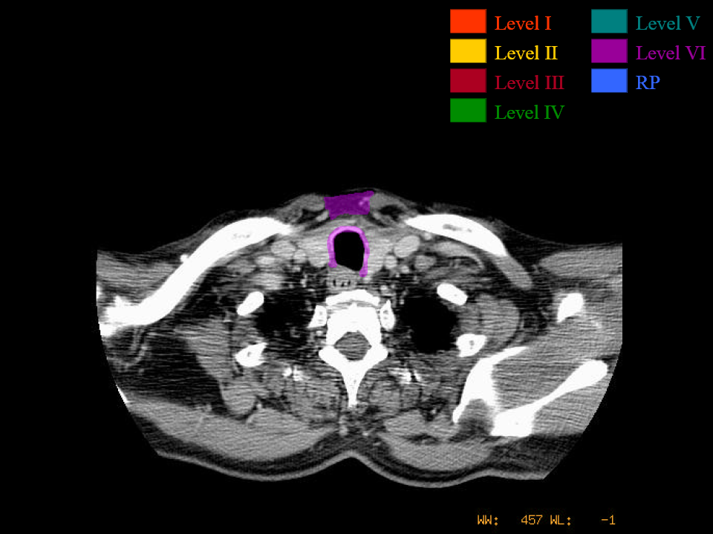

Slide 43
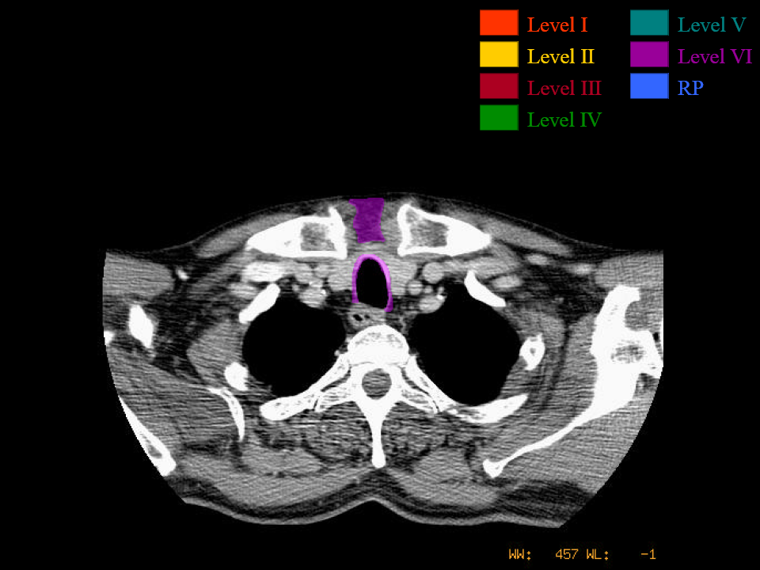

Slide 44
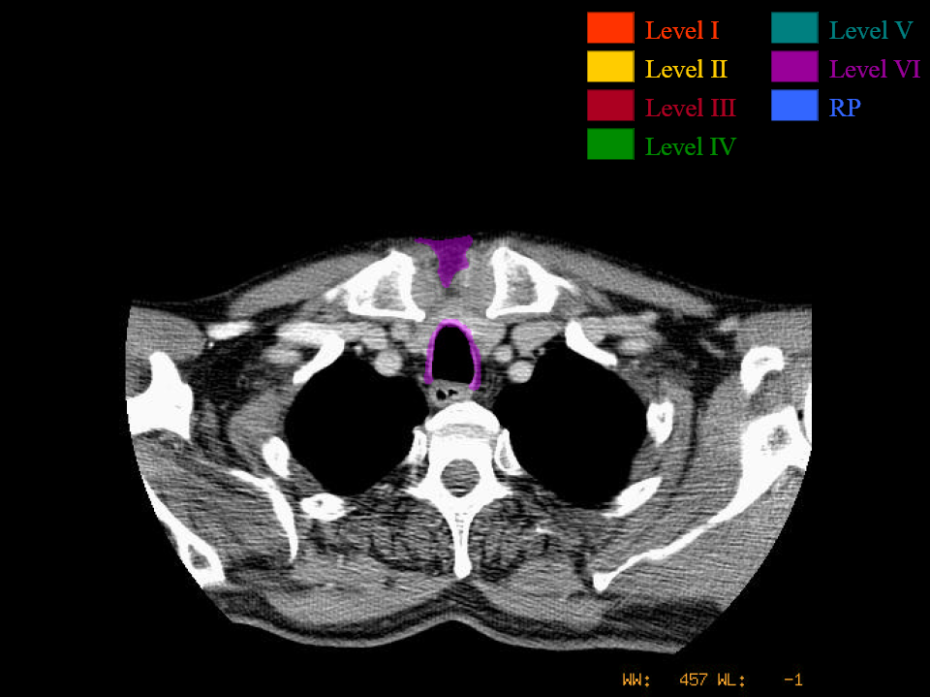

Slide 45
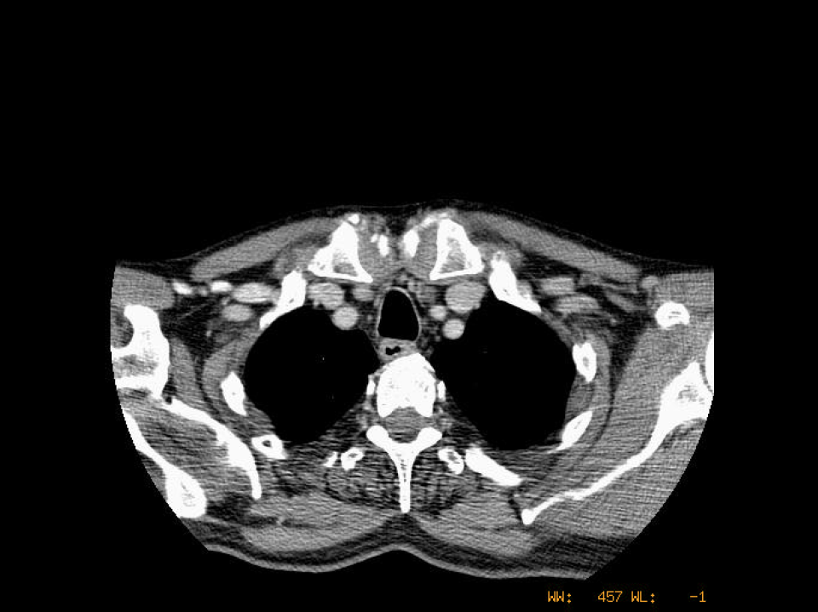
Level VI ends at manubrium

Slide 46
